Slide 1
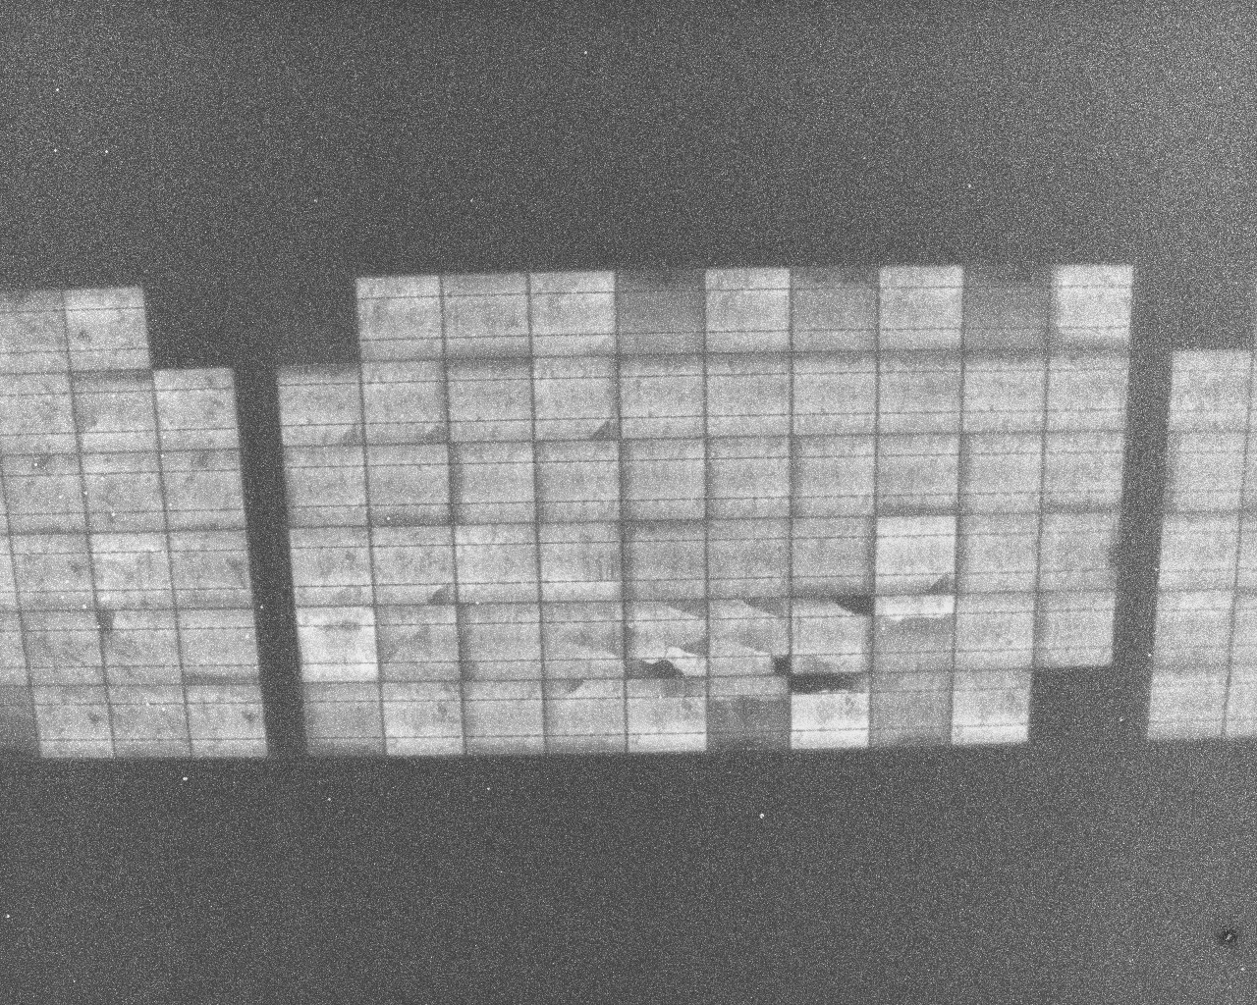
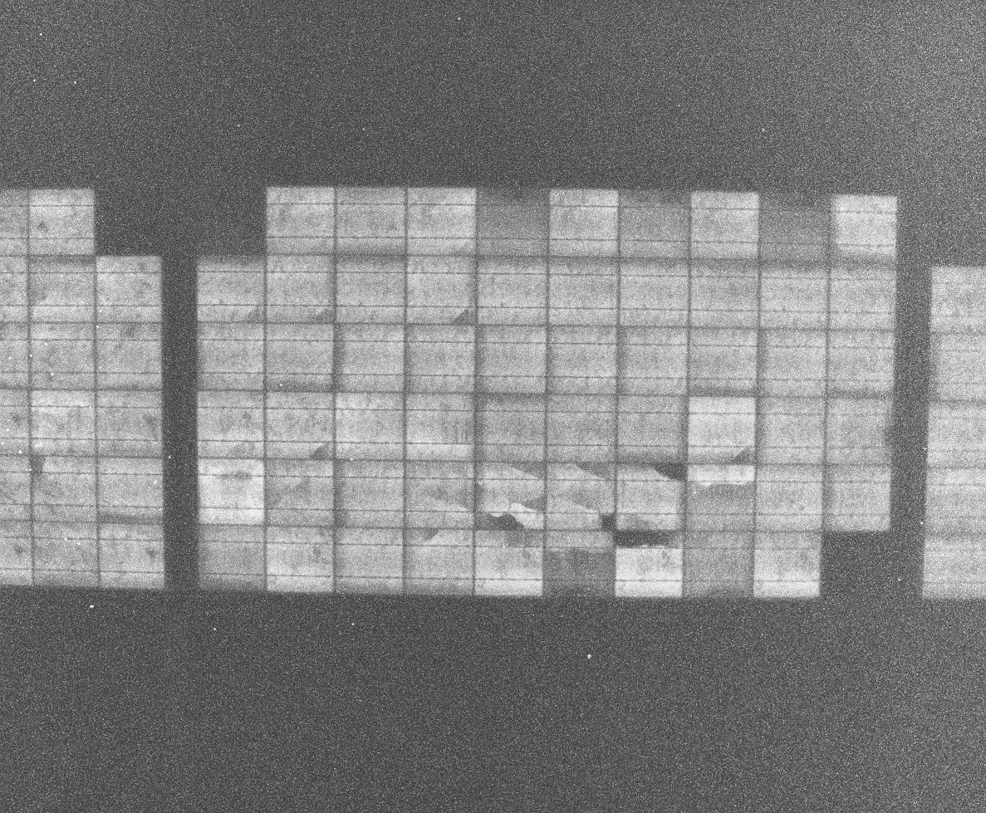
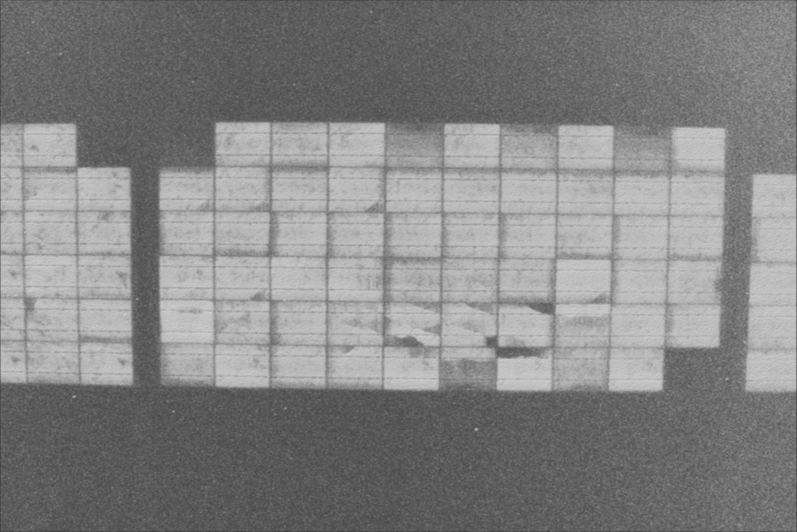


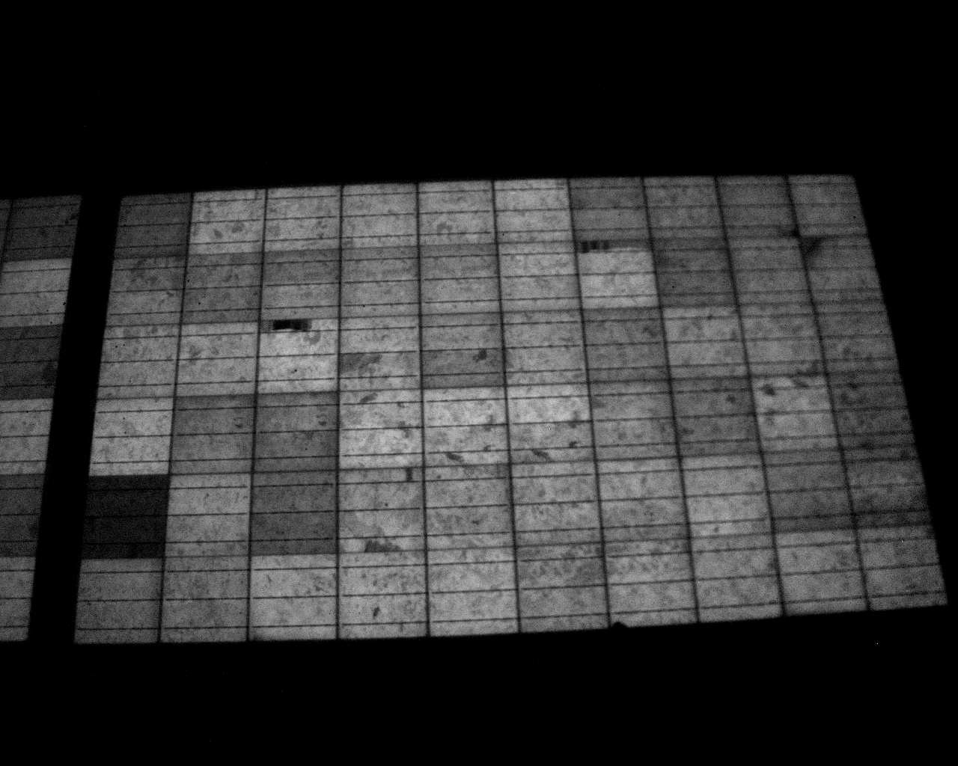
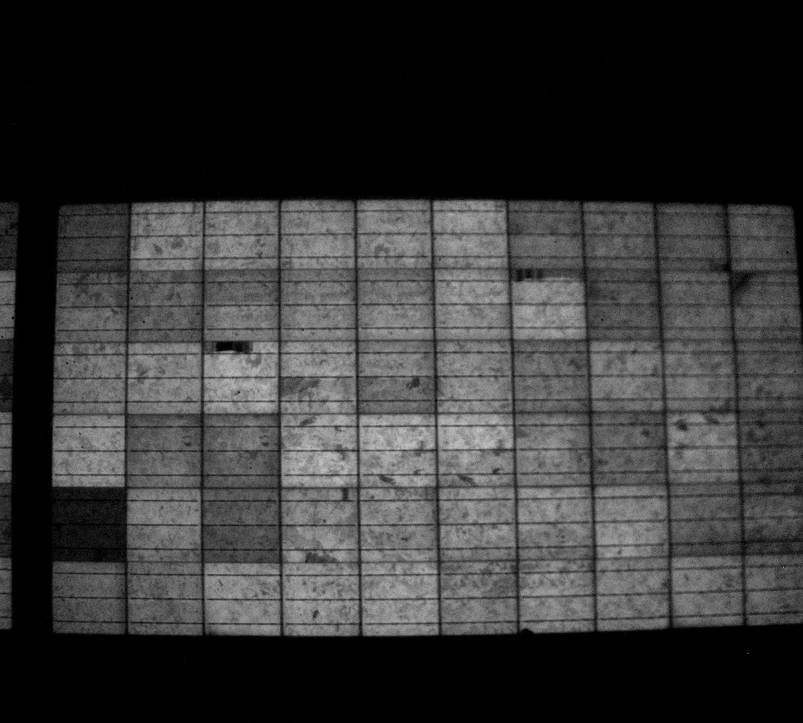

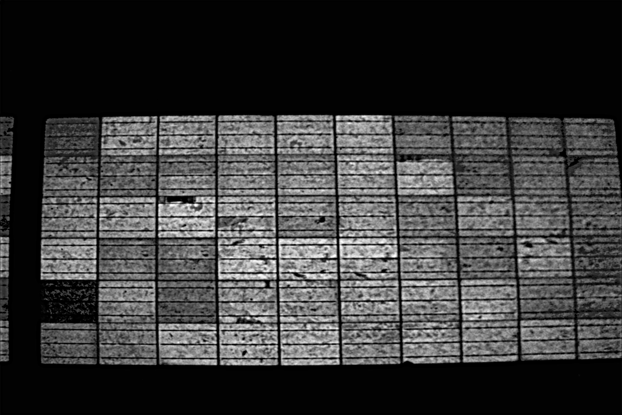
(a)
(b)
(c)
(d)
(e)
Original de-skewed
Denoised
Sharped
20 cm
20 cm
20 cm
20 cm
10 cm
(f)
(g)
(h)
(i)
(j)
Original de-skewed
Denoised
Sharped
20 cm
20 cm
20 cm
20 cm
10 cm
Original
De-skewed [%%]
Denoised
Sharped
Zoomed

